Slide 1

David LeMay M.D.
Regenesis
Sports Nutrition:
The role of Specialized Pro-Resolving Mediators – SPMs - in sports related
health situations

Slide 2
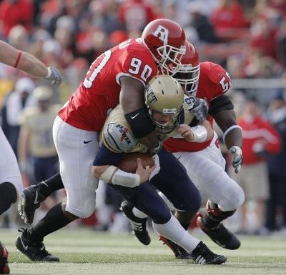
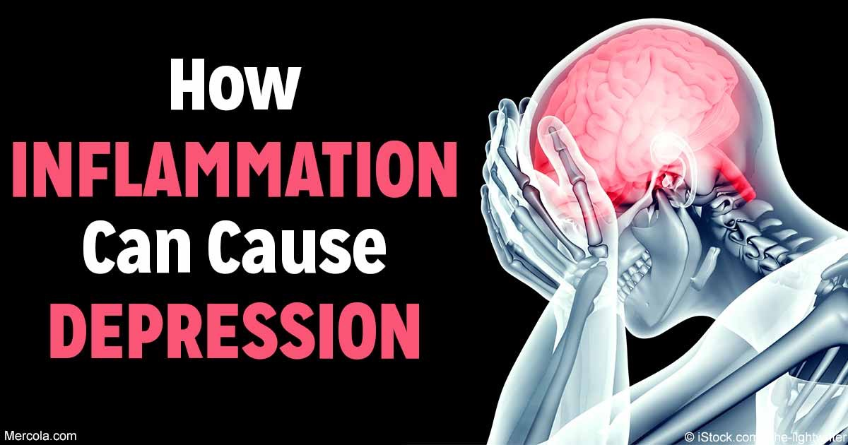
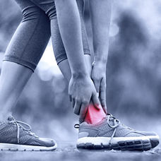

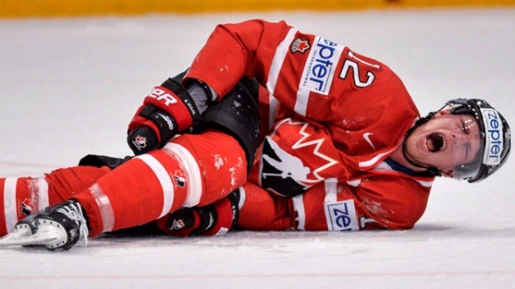
Common thread between Sport Injuries and Trauma
Traumatic Brain Injury (TBI) and Concussions
INFLAMMATION
is a unifying component of many of the diseases that afflict Western civilizations
It is also a major contributor to the magnitude and persistence of sports injuries and traumas
Post Traumatic Stress Disorders (PTSD)
Sports Injuries

Slide 3
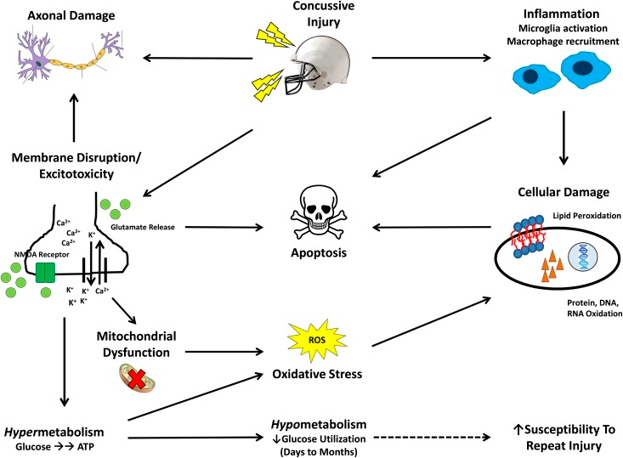
Role of inflammation in Concussion / TBI
From Barrett EC et al, Adv Nutr. 2014; 5(3):268-277

Slide 4
Scientific Evidence relating Inflammation
to Concussions and TBI
Conditions | Relation with chronic inflammation | References
Concussion & Traumatic Brain Injury (TBI) | Inflammation appears to be the underlying factor behind the symptoms of traumatic brain injury, it is common among virtually every symptom of post-concussion syndromes | Rathbone ATL. et al, Brain, Behavior and Immunity 2015; 46:1-332
 | Emerging experimental work demonstrates that persistent neuroinflammation can cause progressive neurodegeneration that may be treatable even weeks after traumatic injury | Faden AI et al, Br J Pharmacol 2016; 173(4): 681-691
 | Neuroinflammation contributes to tau (a major driver of cognitive decline) accumulation in chronic traumatic encephalopathy | Cherry JD et al, Acta Neuropathol Commun 2016; 4(1):112

Slide 5
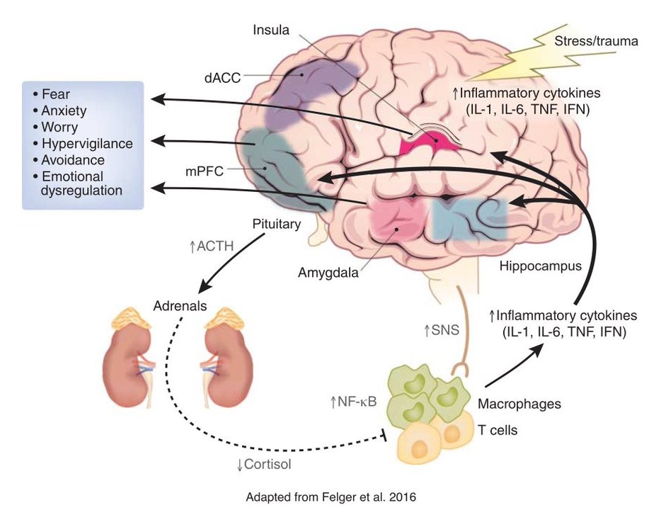
Role of inflammation in PTSD
Available data suggest that targeting inflammation may serve as a therapeutic target for treating fear- and anxiety-based disorders
From Michopoulos et al, Neuropsychopharmacology. 2017 Jan;42(1):254-27

Slide 6
Scientific Evidence indicating of the Importance
of Inflammation in Traumas
Conditions | Relation with chronic inflammation | References
Post-Traumatic Stress Disorder (PTSD) | Accumulating evidence indicates that elevated inflammation may play a causal role in the development of PTSD symptoms, and in PTSD-related increased risk for cardiovascular, autoimmune, and neurodegenerative diseases | Pace TW, Heim CM. Brain Behav Immun. 2011; 25:6–13. O’Donovan A, Slavich GM, Epel ES, Neylan TC. Neurosci Biobehav Rev. 2013 Jan 31.37:96–108
 | A meta-analysis indicates that inflammatory markers are significantly higher in individuals with PTSD versus without, and greater illness duration was associated with higher levels of IL-1β and that greater severity of PTSD symptoms was associated with higher levels of IL-6 | O’Donovan A, Evid Based Ment Health 2016: 19(4); 120

Slide 7
Why do we have inflammation?
Why is inflammation beneficial?
Inflammation is essential for our wellbeing
Inflammation is a natural and well-coordinated process of protecting the organism in response to infection or tissue damage
Acute inflammation is characterized by:
Heat | Edema
Redness | Pain
Swelling | Accumulation of neutrophils, monocytes and macrophages
Acute inflammation serves to:
Eliminate the initial cause of cell injury
Remove necrotic cells and tissue
Initiate the process of repair

Slide 8
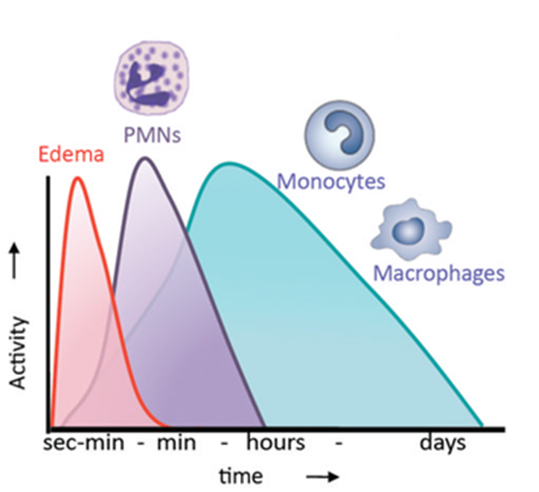
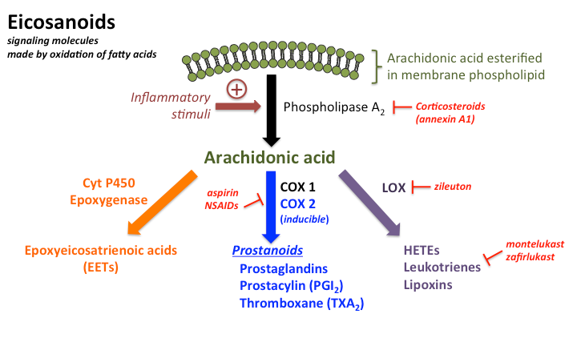
The Inflammatory Process
Inflammation involves several types of cells and chemical mediators
Inflammation initiation and progress are driven by pro-inflammatory mediators: leukotrienes and prostaglandins, derived from arachidonic acid
From Serhan et al, Chem. Rev 2011;111(10)
What is the problem with inflammation?
  Inflammation process must be time-limited and resolve in a timely fashion

Slide 9
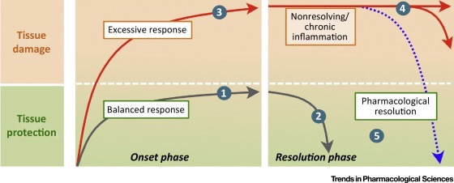
What if inflammation does not resolve itself naturally ?
Without resolution, prolonged acute inflammation can become chronic and provoke tissue damage
SPM-DRIVEN RESOLUTION
Modifed from Perretti, Mauro et al. Trends in Pharmacological Sciences, Volume 36, Issue 11, 737 - 755
Chronic inflammation is the underlying cause of a wide range of diseases and conditions

Slide 10
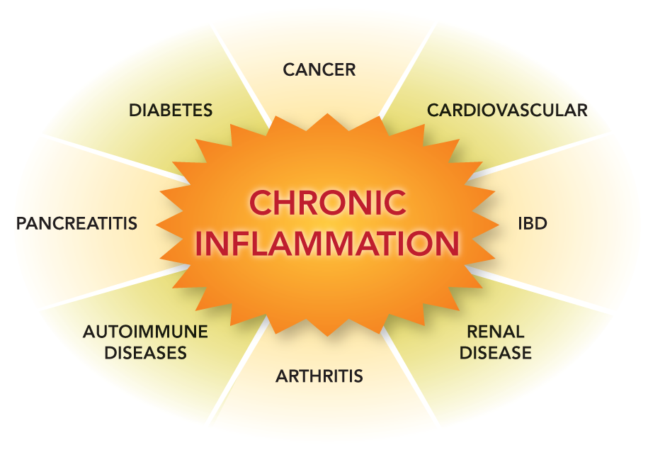
Inflammatory-Driven Diseases & Conditions
OBESITY
STROKE
CONCUSSIONS
& TBI
PTSD
ASTHMA
CYSTIC FIBROSIS
ALZHEIMERS DISEASE
CHRONIC INJURIES

Slide 11
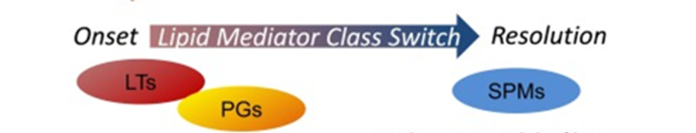
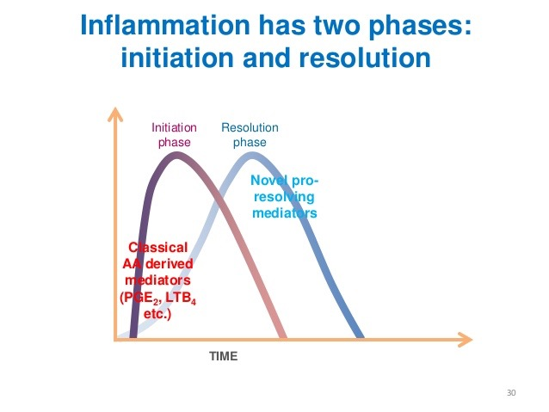
What leads to the natural resolution
of inflammation?
Inflammation Resolution Phase
Active phase
Involves specific mediators recently discovered:
Specialized Pro-Resolution Mediators
or SPMs
SPMs allow the return
to normal functions
SPMs promote tissue repair and regeneration

Slide 12
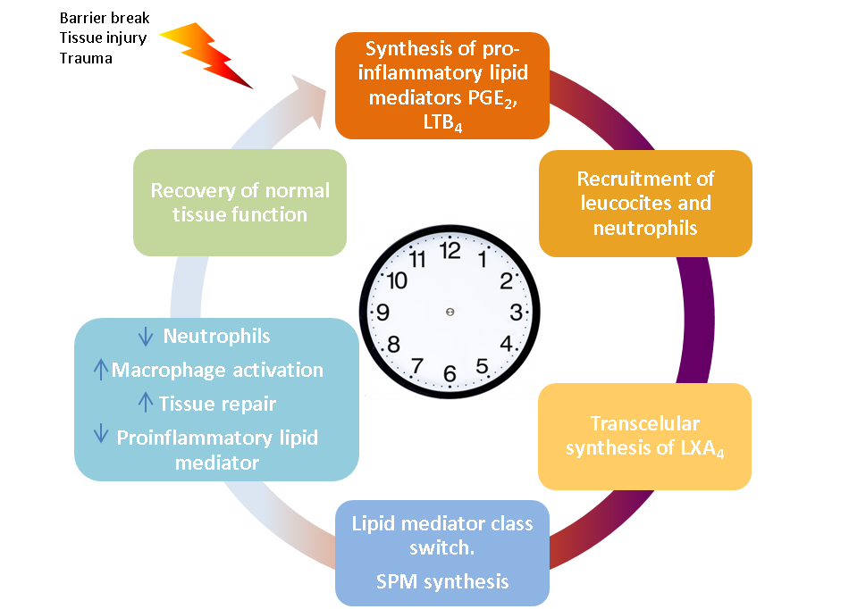
How do SPMs work in tissue injury or trauma ?
Inflammation initiation and progress are driven by PROINFLAMMATORY mediators , which lead the recruitment of neutrophils that kill bacteria and are required for production of Lipoxin-A4 (LXA₄) .
1
2
1
2
3
7
LXA₄ counter-regulates production of pro-inflammatory signals and promotes resolution by enabling the biosynthesis of PRO-RESOLUTION mediators (SPMs).
The natural underlying mechanism that drives inflammation resolution is the lipid mediator class switch that will promote tissue repair and return to homeostasis .
In normal conditions, inflammation is naturally programmed to resolve through SPMs actions, allowing the body to return to normal function.
4
3
5
6
7
6
4
5

Slide 13
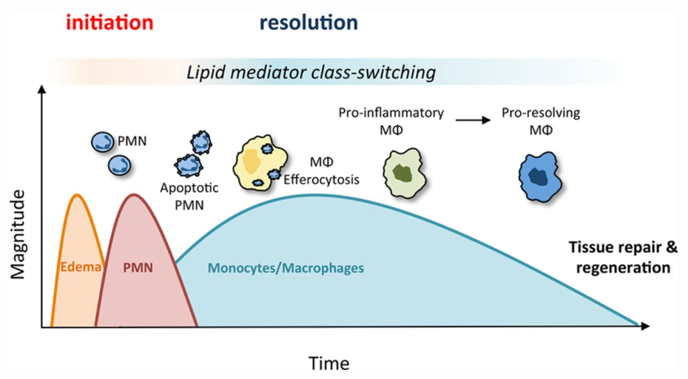
SPMs drive the orchestrated process of resolving inflammation
«
Sec-min
Min
Hours
Days
The temporal switch in lipid mediators biosynthesized by leukocytes in the tissue, is critical to the progression of inflammation from initiation to resolution.
ARA
EPA
DHA
COX
5 LOX
15 LOX
COX
COX / 15 LOX
12 LOX
Tromboxanes
Leukotrienes
18 HEPE
17 HDHA
14 HDHA
Prostaciclines
LIPID MEDIATOR CLASS SWITCH
5LOX
5LOX
Lipoxines
Prostaglandines
PGE2 PGD2
E-RESOLVINS
D-RESOLVINS
MARESINS
PROTECTINS
INFLAMMATION
RESOLUTION

Slide 14
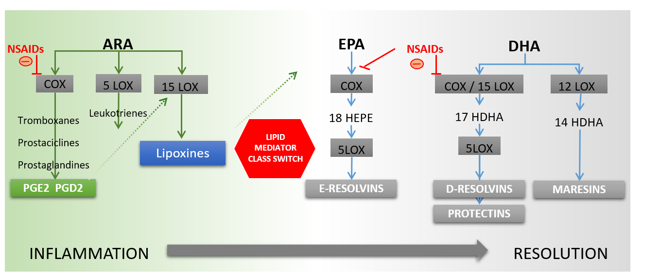
NSAIDs interfere with natural SPMs synthesis
Traditional anti-inflammatories (NSAIDs) inhibit, suppress or block the natural inflammatory response therefore delaying or impeding resolution. This delay can lead to immune suppression, unlike SPMs.
NSAIDs block prostaglandin production and inhibit cardinal sign at the onset of inflammation, halting resolution by inhibiting lipoxin A synthesis.

Slide 15
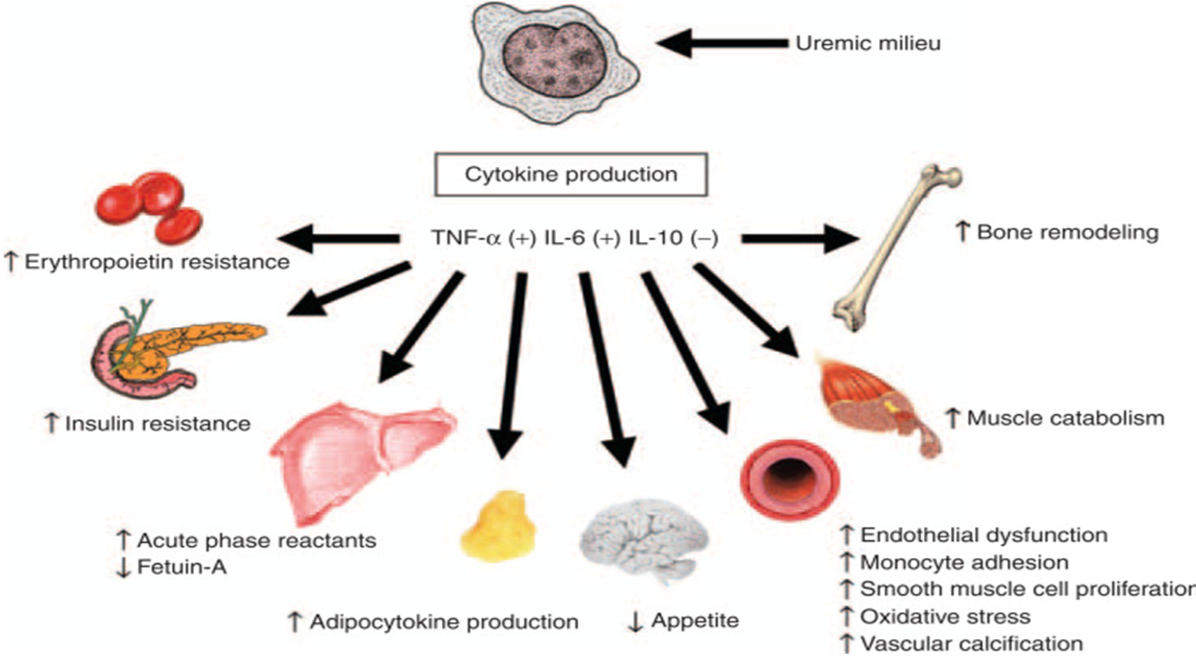
SPMs Actions on Cytokine Production
SPMs counteract inflammatory cytokines bad effects
SPMs decrease TNF-α and IL-6 synthesis and increase IL-10 synthesis

Slide 16
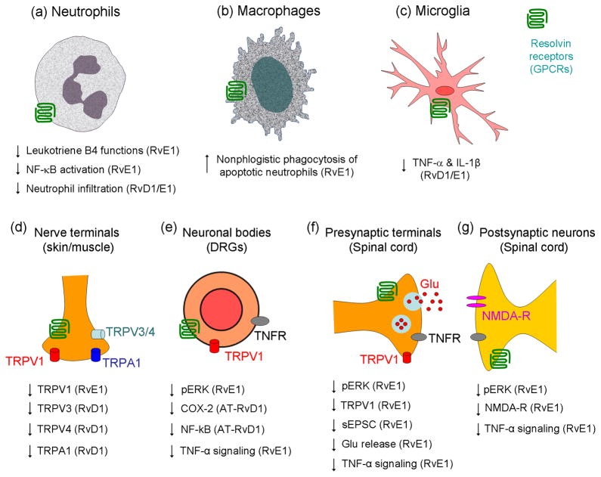
SPM’s and Pain
SPM’s have an effect:
  Presynaptic
  Postsynaptic

Slide 17
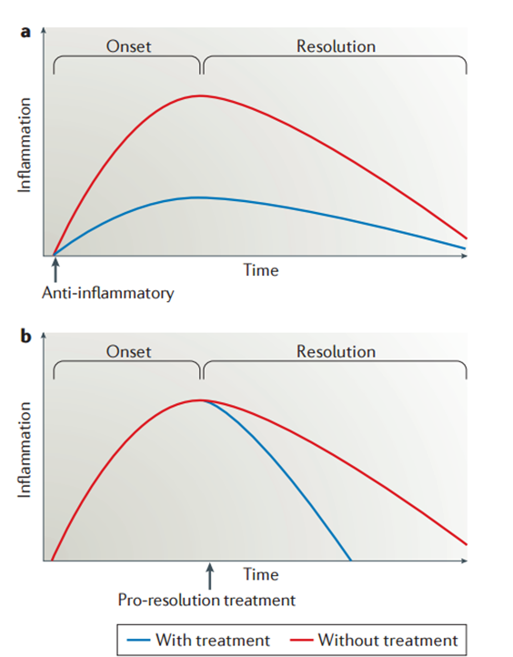
Anti-Inflammatory vs. Pro-Resolution
Nature reviews Drug Discovery (5) 2016, Fullerton AN & Gilroy D
Conventional anti-inflammatory treatments (i.e. NSAIDs) inhibit modulators that drive inflammation, halting the process and resulting in side effects
SPMs do not block the initial inflammation phase
Instead, SPMs promote the natural termination of the inflammation process
SPMs resolve inflammation without compromising the immune response and causing risky side effects
SPMs promote tissue repair and regeneration

Slide 18
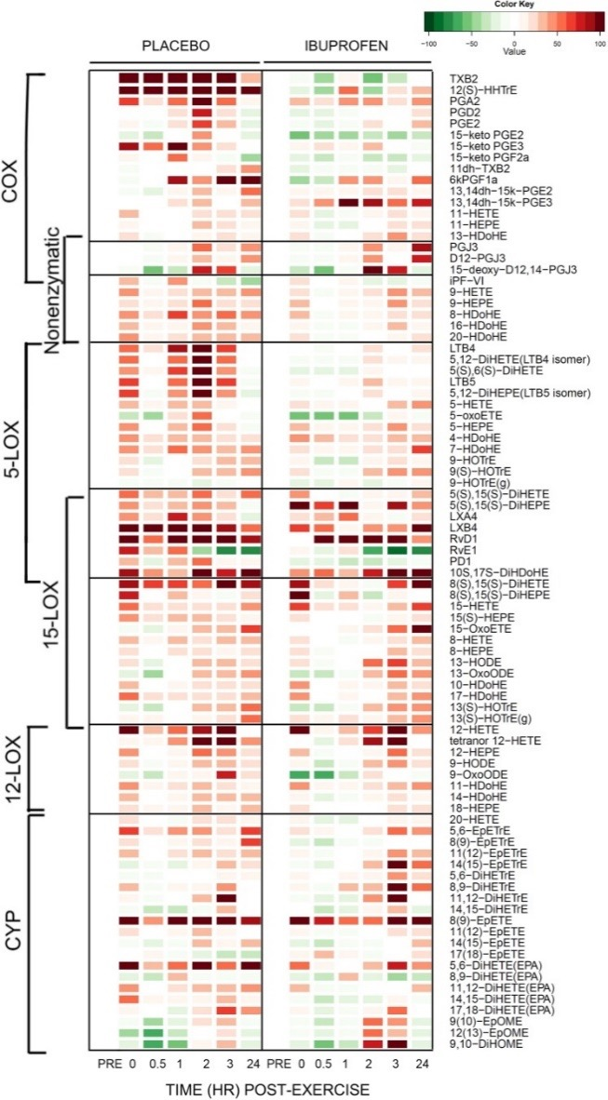
Clinical Evidence
A recent human study (Markworth JF et al, 2013;305(11)) involving lipidomic profiling presented data characterizing the acute inflammatory and SPMs response after unaccustomed resistance exercise.
Elevated levels of SPMs were observed during both the early (0–3 h post exercise) and later (24 h post exercise) stage of recovery
Treatment with ibuprofen (COX-1/COX-2 inhibitor) blocked the prostaglandin response to exercise, but more surprisingly, also abolished leukotriene biosynthesis and led to a diminished SPM response during post exercise recovery.
Authors proposed that the SPMs may play a previously unappreciated role in immunological and adaptive muscle signaling responses during the early post exercise recovery period.
Their findings also suggest that the use of anti-inflammatory interventions to enhance post exercise recovery may be at the cost of delayed and/or diminished natural resolution of the inflammatory response to exercise

Slide 19
Anti-Inflammatory vs. Natural Pro-Resolution
PAST
FUTURE
SPMs
Push for resolution
Push back inflammation
Pro-inflammatory mediators
INFLAMMATION
TIME
Modified from Nature reviews Drug Discovery (5) 2016, Fullerton AN & Gilroy D

Slide 20
SPMs vs. Omega-3 EPA and DHA
EPA and DHA are converted to SPMs through an enzymatic process.
This conversion may be compromised or decreased due to physical stress or abuse of anti-inflammatory drugs (i.e. NSAIDs), therefore delaying the process of resolving inflammation naturally.
Food
Standard Dietary Supplements
Specialized Nutrition
Drugs
SPM and SPM direct precursors are the most potent agents for natural inflammation resolution.
Inflammation Resolution Capability
Fish
Fish Oil
O-3
EPA/DHA
SPMs
MaR1, RvD1,
Etc.

Slide 21
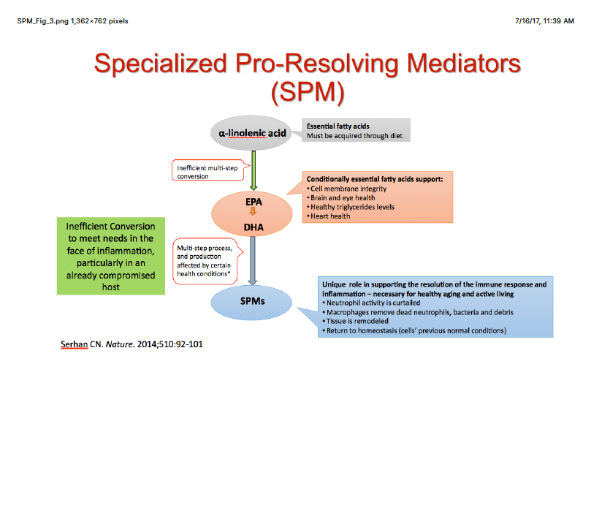
Why Not Just Take Omega 3?

Slide 22
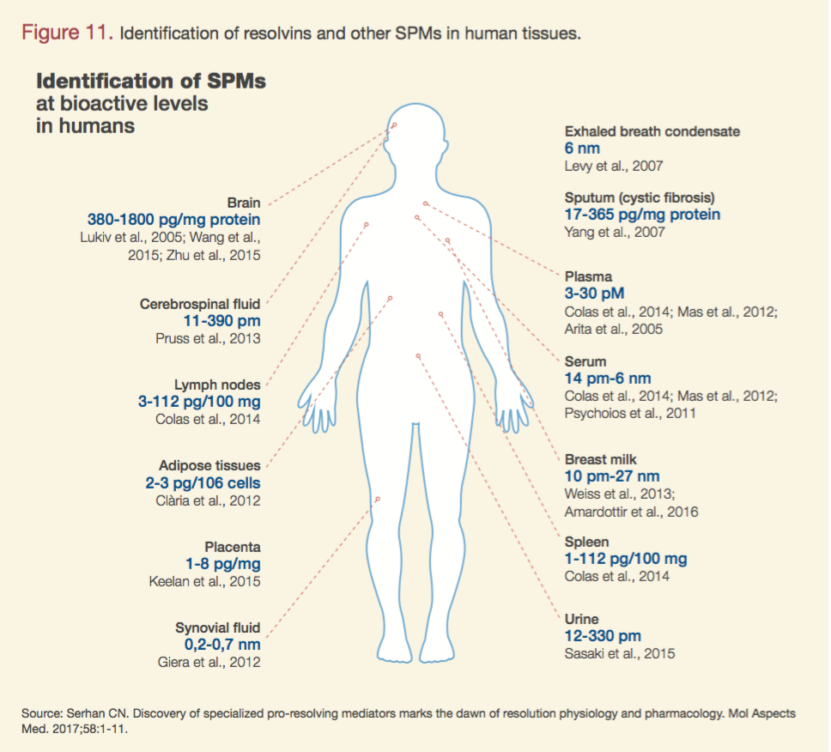
Are SPM’s Safe?
Found in body fluids

Slide 23
Clinical Evidence
Clinical evidence demonstrates Omega-3 EPA and DHA provides benefits in the following situations related to sports and trauma:
Product | Conditions | Observations | References
DHA-rich fish oil | Acute exercise | Reduces markers of muscle damage, inflammatory disturbances and neutrophil death induced by acute exercise | Marques CG et al, Appl Physio Nutr Metab. 2015; 40:596-604
Omega-3 | Neuromuscular function and performance in male athletes | Improves peripheral neuromuscular function, aspects of fatigue and neuromuscular function | Lewis EJH et al, J Int Soc Sports Nutr. 2015; 12:28
DHA | Training and acute exercise | Exercise and DHA act synergistically and promote anti-inflammatory marker | Capo X. et al, J Int Soc Sports Nutr. 2016; 13:16
EPA & DHA | Eccentric contractions-induced muscle damage | Attenuates strength loss and limited range of motion after exercice | Tsuchiya T et al, Eur J Apli Physiol. 2016; 116: 1179-1188
DHA | Head trauma in American Football | Suggests a neuroprotective effect of DHA | Olivier JM et al, Med & Science in Sports & Exc. 2016; 974-982
Omega-3 | Depression | Suggests an antidepressant efficacy | Lin P-Y et al, J Clin Psychiatry. 2007:1056-1061
High EPA | Exercise-induced muscle damage (EIMD) | Ameliorates the functional changes following EIMD | Jakeman JR et al, Eur J Appl Physiol. 2017; 117(3):575-582

Slide 24
Parathyroid and SPM Production in Bone
- Bone marrow macrophages stimulate skeletal wound repair and osteoblastic formation
-LCMS revealed higher levels of SPM’s in bone marrow relative to the spleen
-Parathyroid hormone increased SPM levels including resolvin in bone marrow.
-Human and Murine primary macrophages efferocytosed apoptotic osteoblasts in vitro which is enhanced by RvD1 and RvD2
-Contribute to a feedback system for resolution of inflammation and maintenance of skeletal homeostasis
Cutting Edge: Parathyroid Hormone Facilitates Macrophage Efferocytosis in Bone Marrow via Proresolving Mediators Resolvin D1 and Resolvin D2
Laurie K. McCauley, Jesmond Dalli, Amy J. Koh, Nan Chiang and Charles N. Serhan
J Immunol July 1, 2014, 193 (1) 26-29; DOI: https://doi.org/10.4049/jimmunol.1301945

Slide 25
SPM’S ARE RELEASED BY STEM CELLS
Human periodontal ligament stem cells biosynthesize SPM’s including Resolvin D1, D2, D5, and D6
They also synthesize protection D1, Maresins and LXA4 in addition to PG E2
LXA4 significantly enhanced proliferation, migration and wound healing capacity of human periodontal ligament stem cells.
Promote resolution of inflammation and increase bacterial killing
Cianci E. Human Periodontal Stem Cells Release Specialize Proresolving Mediators and Carry Immunomodulatory and Propelling Properties Regulated by Lipoxins. STEM CELLS TRANSI MED. 2016 JAN;5(1):20-32.

Slide 26
Conclusions
Sports injuries are often treated with anti-inflammatory drugs (NSAIDs) .
Prolonged sports activity can provoke inflammation which can be mild, severe, sub-acute or chronic which may impair performance and lessen available training time.
Injury-induced inflammation initially acts as a host defense mechanism
Abuse of anti-inflammatory drugs (NSAIDs) to treat this injury-induced inflammation inhibit the natural creation of SPMs by the body, therefore creating an immune function imbalance.
The timing of the protective function of the inflammatory response is vital, since chronic inflammation is associated with progressive cell loss and toxicity
Enhancing SPM production, both endogenous and exogenous, represents a valuable target in shifting the balance of inflammatory processes from inflammation-driven to inflammation-resolving conditions
Enhancing SPM production, both endogenous and exogenous, can help prolong exercise time, intensity of training, overall performance and reduce recovery time from injury and severity of sympotoms without the use of anti-inflammatory drugs or prohibited strength enhancing substances.

