Slide 1
David LeMay m.d. regenesis
Concussion

Slide 2
Concussion/mTBI
Direct blow to the brain
Indirect blow that results in shearing forces diffusely across the brain
  Blast exposure

Slide 3
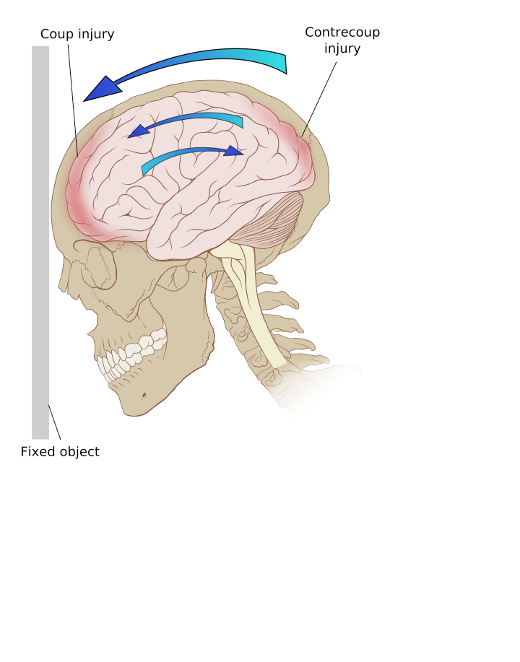
Coup vs Contracoup

Slide 4
Definition
The American Congress of Rehabilitation Medicine definition of MTBI
“A traumatically induced physiologic disruption of brain function, including:
  Any period of loss of consciousness
  Any loss of memory for events immediately before or after the accident
  Any alteration in mental state at the time of the accident
  Focal neurological deficits that may or may not be transient but where the severity of the injury does not exceed LOC<30 min, GCS 13-15, and PTA < 24 hours

Slide 5
Symptoms
May be subtle
Can last for days up to permanent. Most commonly symptoms resolve in a week

Slide 6
Symptoms
Headache
Mental fog or confusion
Amnesia
Dizziness
Ringing in the ears
Nausea with or without emesis
Delayed response to questions
Fatigue

Slide 7
Other symptoms- delayed
Concentration difficulty
Irritability
Photophobia
Sleep disturbances
Depression
Disorders of taste and smell

Slide 8
Pathophysiology
Primary versus secondary injury in TBI
Primary
  Directly related to the site of injury
  Coup
  Contracoup
  Axonal shearing
Secondary
  Metabolic and inflammatory changes that occur within the brain.
  Release of excitatory neurotransmitters (including sympathetic dominance)
  Production of free radicals and decrease of cerebral perfusion

Slide 9
  Neuroendocrine Dysfunction
Prolonged inflammatory exposure or oxidative stress may lead to a problem with hormone disruption which further promotes the inflammatory problem and can lead to a catabolic state.
Is this “Tirtiary Injury” or a continuum of the secondary injury?????

Slide 10
Pituitary Dysfunction
Occurrence of pituitary injury in TBI
  37.5% in mild
  57.1% in moderate
  59.3% in severe TBI
  No relationship was detected between the pituitary dysfunction and years since TBI
  Hypogonadism (14%), hypothyroidism (10%), high prolactin (8%), low prolactin (8%), HGH (20%) and severe GHD (8%).
  Overall risk was 54%
  Bondanelli M, et al. Occurance of Pituitary Dysfunction Following Traumatic Brain Injury. J Neurotrauma. 2004

Slide 11
Blast related mTBI
Chronic hypopituitarism – defined by deficient production of one or more pituitary hormones at least 1 year after the injury in between 25-50% of TBI and in 42% of those exposed to blast concussion.
Most common were GHD, hypogonadism
Symptoms resemble those of PTSD including fatigue, anxiety, depression, irritability, insomnia, sexual dysfunction, cognitive deficiencies, and decreased quality of life.
Wilkinson, C.W. et al. High Prevalence of Chronic Pituitary and Target-Organ Hormone Abnormalities after Blast-Related Mild TBI. Front Neurol. 2012; 3: 11

Slide 12
Understanding Secondary Injury
Increased inflammation and immune activation
Metabolic/energy production disruption
Imbalance of neurotransmitter function

Slide 13
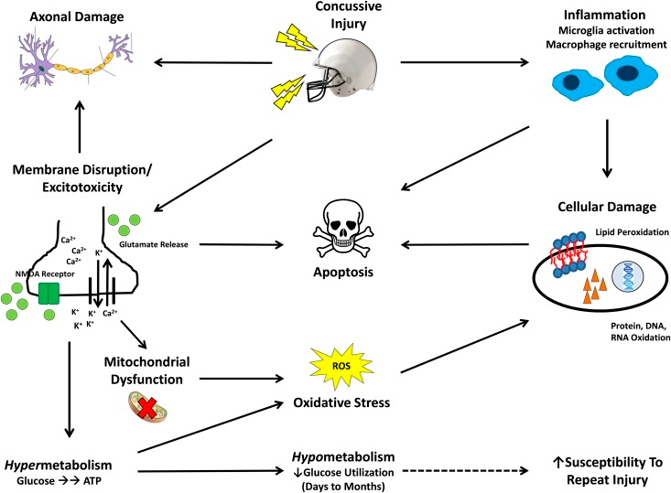

Slide 14
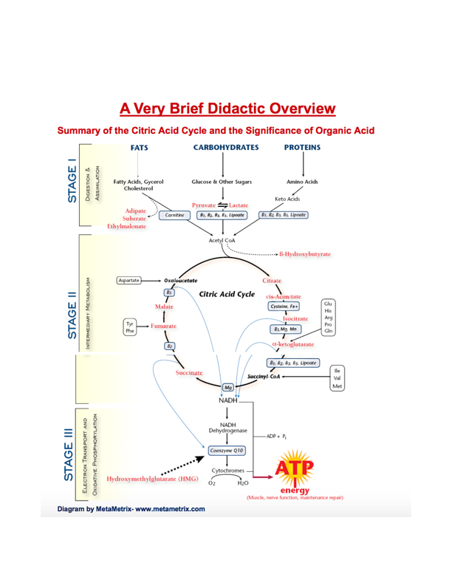

Slide 15
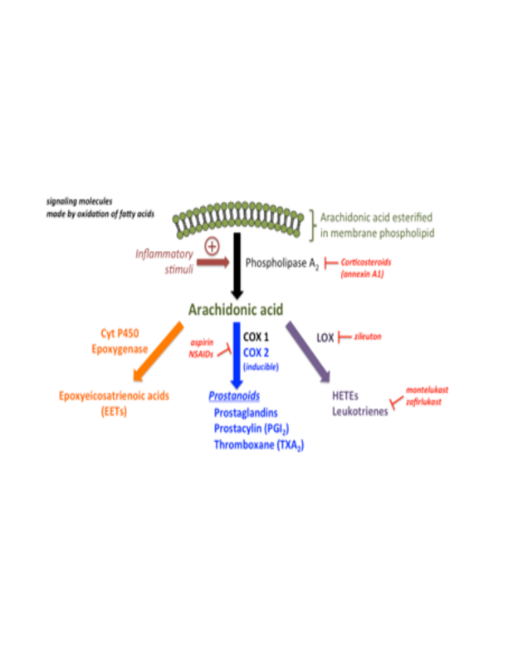
Inflammation Chemical Cascade

Slide 16
NFL Study
Neuroinflammation and brain atrophy in former NFL players: An in vivo multimodal imaging pilot study
Highlights
  Imaged with PET to study a marker of inflamation
  Several brain regions showed signs of neuroinflammation
  Hippocampal atrophy was also observed on the MRI of the same players

Slide 17
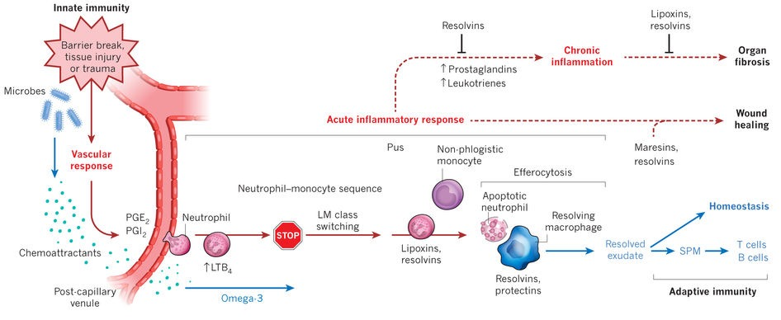
Inflammation
Min

Slide 18
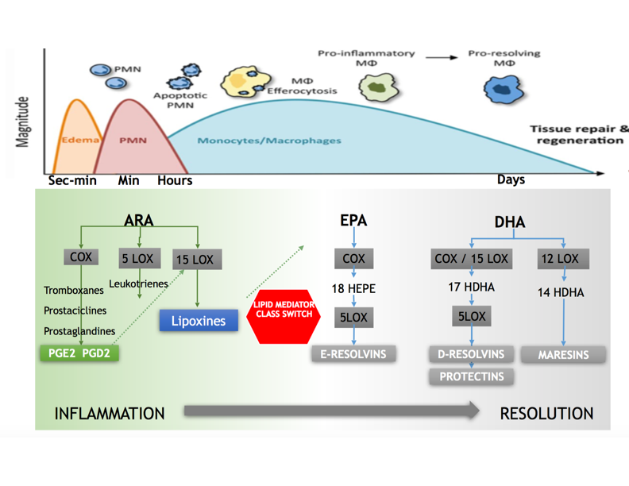
Normal Healing

Slide 19
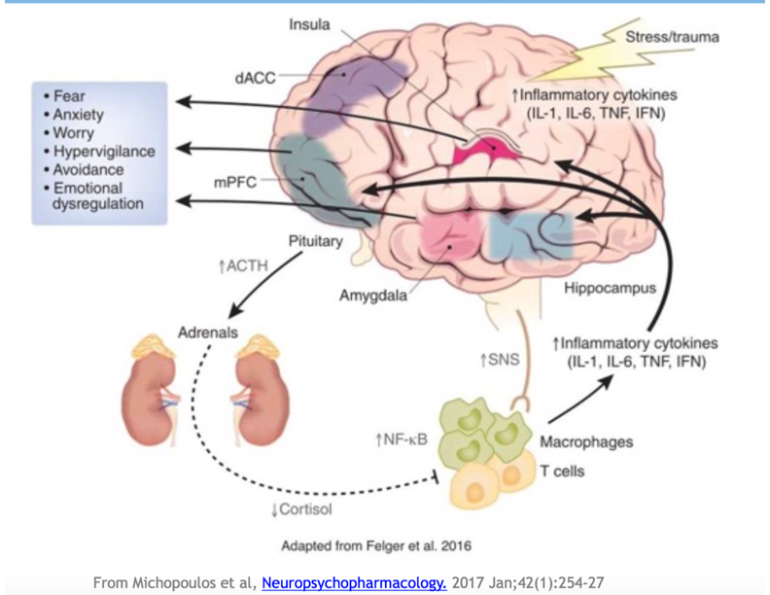

Slide 20
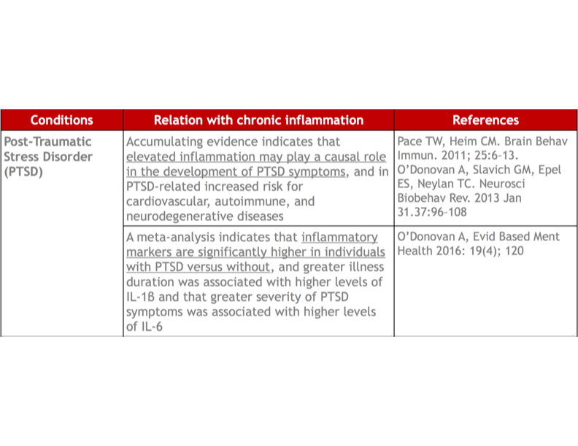
PTSD and Inflammation

Slide 21
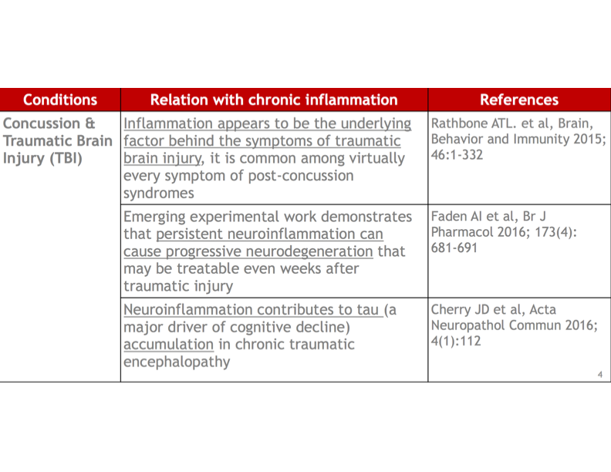
Concussion and Inflammation

Slide 22
Neurotransmitters
Sympathetic | Parasympathetic
Dopamine - motivated | GABA- calm Helps sleep, repair in brain
Norepinephrine | Seratonin- happy
Adrenalin- requires cortisol for manufacture. Raises heart rate, cardiac output, prioritizes blood flow to vital structures
Glutamate- helps memory. Main stimulator in the brain- high amounts lead to damage of brain tissue (concussion)

Slide 23
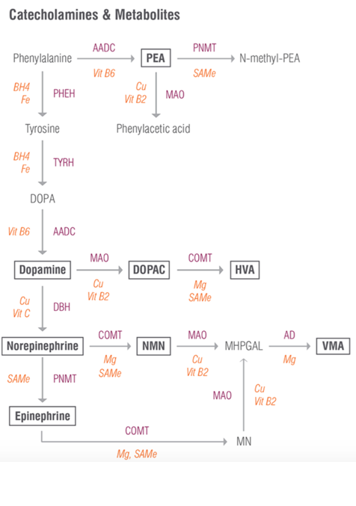
Neurotransmitter - catecholamines
Amino acids- Phenylalanine, Tyrosine - serum
Cofactors- Iron, BH4, B6
Breakdown
  Cofactors - copper, B2, Vitamin C, SAMe, Magnesium
  Vanilmandelate, Homovanillate - urine testing

Slide 24
BH4 - cofactor
Inflammation will lower levels of BH4.

Slide 25
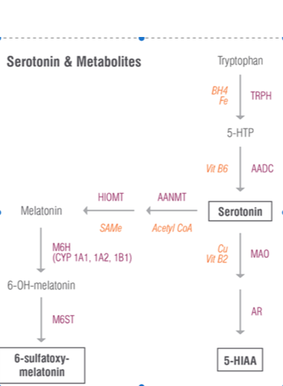
neurotransmitter-Serotonin
Amino acid- Tryptophan
Cofactors - BH4, Iron, Vitamin B6
Alternative pathways
  Kynurenate, Quinolinate
    Inflammation (IDO) and lack of cofactors
Breakdown
  SAMe, Copper, B2
  5-HIAA

Slide 26
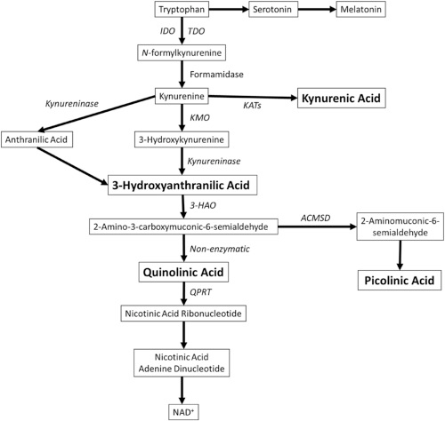
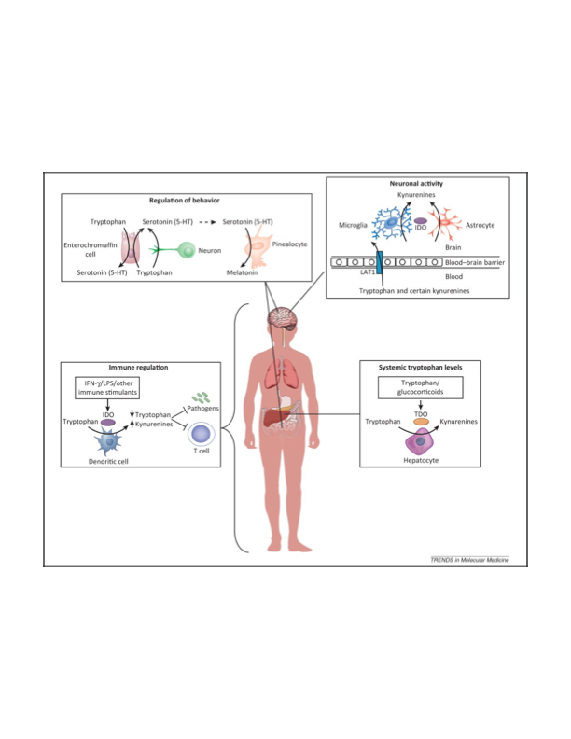
Kyn/Quin - inflammation
Indolamine induced by inflammation.
Increased inflammatory markers are present in suicidal patients.
IDO increases shunting of tryptophan to Kynurenate pathways.
  Affects glutamate neurotransmission. Kynurenate protective and Quin harmful. Countered by ketamine.
  Thaler, R et. al. J Biol Chem. 2011 Feb 18;286(7):5578-88.

Slide 27
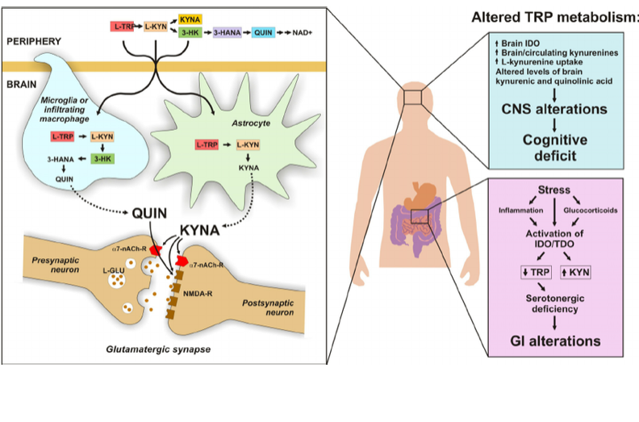
KYN/QUIN

Slide 28
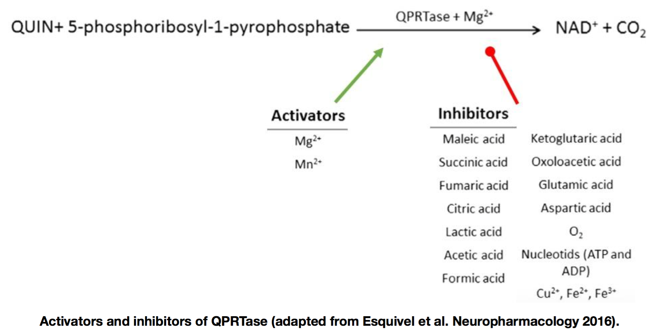
Activation of Quin

Slide 29
  Kyn/QUin ratio and sports concussion
Mood symptoms after a concussion can correlate with a lower ratio of Kynurenic acid to Quinolinic acid.
Lower ratio associated with more depression and anxiety at 1 day post injury, and worse mood symptoms at 1 month post injury.
Concussed athletes with worse concussion outcome (defined as number of days until return to play) had higher Quin and lower Kyn/Quin at 1 month.
Singh R. et. al. J of Neurol Neurosurg Psychiatry. Mood Symptoms Correlate with Kynurenine Pathway Metabolites Following Sports-Related Concussion. 2016 Jun;87(6):670-5.

Slide 30
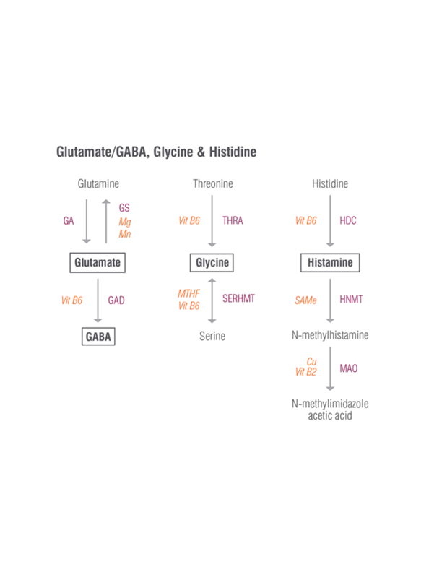
Other Neurotransmitters
Glutamate- main excitatory neurotransmitter. When cortisol is high at night it is difficult to convert to GABA.
Glycine, Threonine, Serine are all calming neurotransmitters. Serine helps to stabilize and regulate the HPA axis. Glycine is involved in detoxification in the liver (particularly exposure to Xylene)
Histidine tends to be high with poor quality protein supplementation and with muscle breakdown. Poor methylation can result in higher histamine levels and increased inflammation. High cortisol can lead to Th2/Th1 imbalance making this worse.

Slide 31
Toxin Exposure
Toxic exposures may exert profound effects when the organism is in a particularly vulnerable stage.
Neurotoxins may reduce the functional reserves of the brain, potentially making the cells more vulnerable to the effects of aging and leading to accelerated senescence. Deterioration may continue for many years, even after the exposure has ceased.

Slide 32
Toxin Exposure
Examples
  Heavy metals- mercury, lead, arsenic
  Organic solvents
  Plastics
  Pesticides (mitochondrial and endocrine disruption)
  Antibiotics (can disrupt mitochondrial function)
  Medications in some circumstances
  Artificial sweeteners - aspartame is a neurotoxin as an example

Slide 33
High Fructose Corn Syrup
Study out of UCLA showed that “a diet high in processed fructose sabatoges rat brains’ ability to heal after head trauma, neuroscientists report. Revealing a link between nutrition and brain health, the finding offers implications for the 5.3 million Americans living with mild TBI”
UCLA Health Sciences. “High-fructose diet slows recovery from brain injury” Science Daily. 2 October 2015

Slide 34
  Alcohol
Impairs the ability of microglia to clear Tau
Depletes B-vitmains which are vital to energy production and neurotransmitter production.
Disrupts sleep - cortisol/GABA dysfunction
Increases Acetaldehyde- toxic to nerves

Slide 35
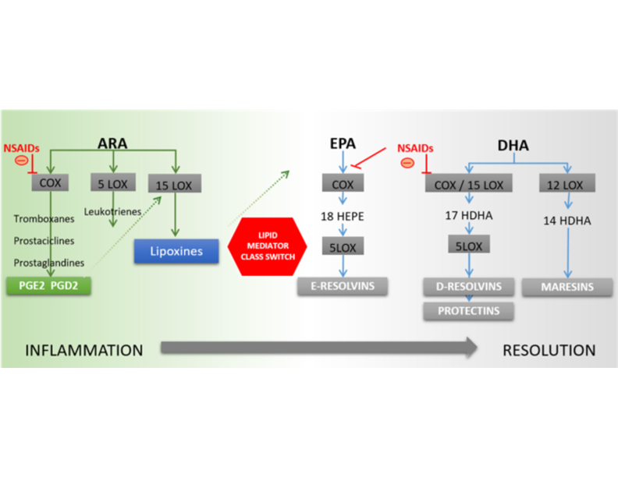
NSAID use and SPM production

Slide 36
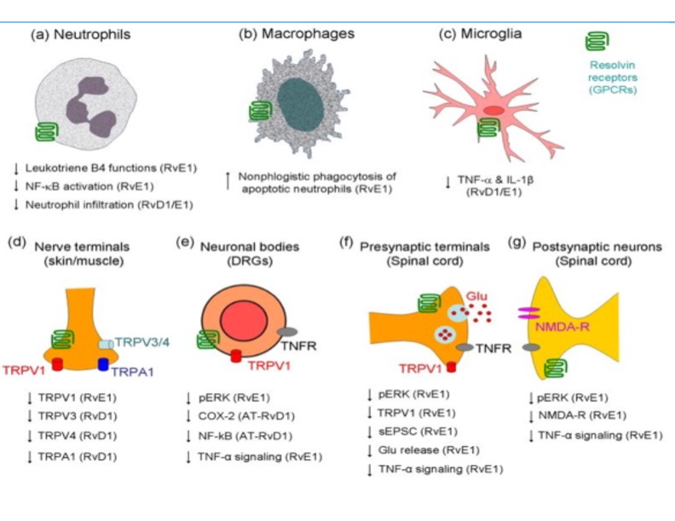
Pro-Resolution Mediators and Central Nervous System

Slide 37
Nutrients
Decreased absorption of nutrients due to stress
Increased turnover and metabolism
Loss of nutrients from metabolism, sweating etc
Increased mitochondrial numbers and enzymes that require nutrients
Increased need for tissue repair
Manore MM. Effect of Physical Activity on Thiamine, Riboflavin and B6 requirements. Am J Clin Nutr. 2000 Aug: 72 (2 suppl): 5985-6065

Slide 38
Nutrients
Marginal deficiency states may only be apparent when metabolic rate is high.
Prolonged strenuous exercise performed on a regular basis may result in increased losses from the body, increased turnover. Results in need for increased dietary intake.
Maughan RJ. Role of Micronutrients in Sport and Physical Activity. Br. Med. Bull. 1999;55(3):683-90

Slide 39
  Nutritional Supplementation
Considered controversial by some
Should be done in concert with good dietary practices
Goal should be to reduce inflammatory load and support mitochondrial function
Hope to support resolution of inflammation to prevent neuroendocrine issues if possible
Using good sources there is almost no downside
  Very rare to have any side effects or reactions to good clean sources (allergic to cellulose, drug interaction in rare cases as examples)

Slide 40
Examples of Supplements That May Have Benefit
CoQ10
NAC
Glutathione
B-vitmains
B-OHB
Creatine
Magnesium
Alpha lipoic acid
Acetyl L-carnitine
Melatonin
Theanine
Curcumin
Specialized Pro Resolving Mediators

Slide 41
N-Acetyl Cysteine
Lowers Oxidative stress
Increases Glutathione
Delays onset of fatigue in athletes (by lowering oxidative stress/free radical production
Lowers glutamate

Slide 42
Ketones
B-hydroxybuterate- may confer neuroprotection against diverse types of cellular injury.
  May enhance neuronal energy reserves, which improve the ability of neurons to resist metabolic challenges, and possibly through other actions including antioxidant and anti-inflammatory effects.
Gasior, Maciej. Et al. Neuroprotective and Disease Modifying Effects of the Ketogenic Diet. Behav Pharmacol. May 5, 2008.

Slide 43
Magnesium
Muscle cramping
Constipation
Anxiety, depression, anger
Insomnia
Behavioral disturbances
Lethargy
Impaired learning and attention
Pain
Headaches
High blood pressure, cardiac conduction problems
Liebsher, D-H. Liebsher, D-E. About the Misdiagnosis of Magnesium Deficiency. Journal of American College of Nutrition Vol. 23, No. 6, 730S-731S (2004)

Slide 44
Magnesium
Serum magnesium measures may not be adequate
99% of magnesium is stored intracellular
Sits in NMDA receptor of the membrane also
Protects mitochondria and may be neuroprotective
Magnesium lowers immune inflammatory cytokine production
  Sugimoto, Jun Et.Al. Magnesium Decreases Inflammatory Cytokine Production: A Novel Innate Immunomodulatory Mechanism. J Immunol June 15, 2012, 188 (12) 6338-6346
60% of US adults were failing to meet RDA for Magnesium according to a study in 1997.
  Institute of Medicine, Food and Nutrition Board, Washington DC: National Academy Press 1997.

Slide 45
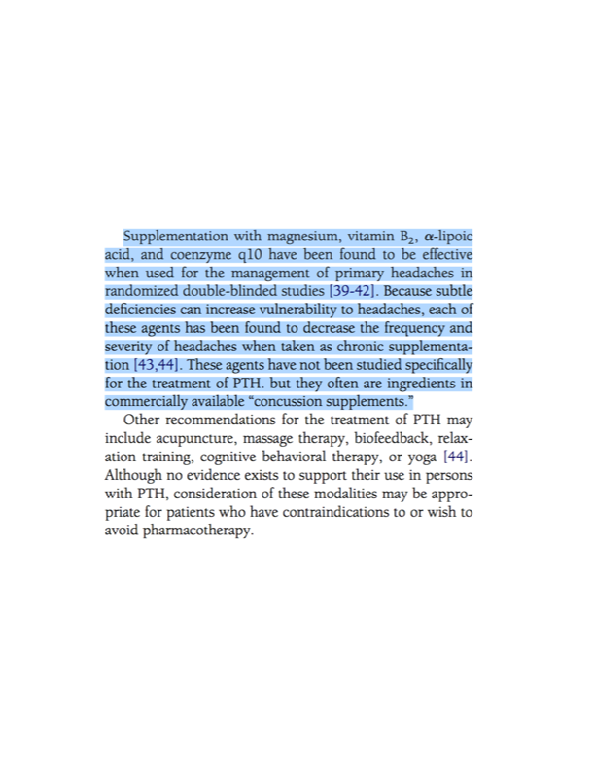
Supplements and PTH

Slide 46
  Genetic Variance
CBS (cystathione-beta-synthase)
  Converts homocysteine and serine to cysteine using B6
  Increases Homocysteine levels in blood and selenium levels if function lowered by genetic issue. Lowers homocysteine if down-regulated (lower glutathione and possible sulfur toxicity)
  Makes it difficult to get rid of heavy metals
MTHFR
  Problems with lowering estrogen (COMT) and producing neurotransmitters (THB)
  Increased risk of cancer, depression, fractures, heart disease, stroke

